Slide 1

Process Synchronization and Deadlocks
Module 3

Slide 2
Outline
Section – 1: Concurrency
Section – 2: Mutual Exclusion
Section – 3: Principles of Deadlock

Slide 3
Multiple Processes
Central to the design of modern Operating Systems is managing multiple processes
Multiprogramming
Multiprocessing
Distributed Processing
Big Issue is Concurrency
Managing the interaction of all of these processes
Notes:
The central themes of operating system design are all concerned with the management of processes and threads:
• Multiprogramming:
The management of multiple processes within a uniprocessor system.
• Multiprocessing:
The management of multiple processes within a multiprocessor.
• Distributed processing:
The management of multiple processes executing on multiple, distributed computer systems.
E. G clusters
Concurrency encompasses a host of design issues, including
communication among processes,
sharing of and competing for resources (such as memory, files, and I/O access),
synchronization of the activities of multiple processes, and
allocation of processor time to processes.

Slide 4
Concurrency
Concurrency arises in:
Multiple applications
Sharing time
Structured applications
Extension of modular design
Operating system structure
OS themselves implemented as a set of processes or threads
Notes:
• Multiple applications:
Multiprogramming was invented to allow processing time to be dynamically shared among a number of active applications.
• Structured applications:
As an extension of the principles of modular design and structured programming, some applications can be effectively programmed as a set of concurrent processes.
• Operating system structure:
The same structuring advantages apply to systems programs, and we have seen that operating systems are themselves often implemented as a set of processes or threads.

Slide 5
Difficulties of Concurrency
Sharing of global resources
Writing a shared variable: the order of writes is important
Incomplete writes a major problem
Optimally managing the allocation of resources
Difficult to locate programming errors as results are not deterministic and reproducible.
Notes:
The sharing of global resources
If two processes both make use of the same global variable
and both perform reads and writes on that variable,
then the order in which the various reads and writes are executed is critical.
Managing Resources
It is difficult for the OS to manage the allocation of resources optimally.
E.G. A process may request use of, and be granted control of, a particular I/O channel and then be suspended before using that channel.
It may be undesirable for the OS simply to lock the channel and prevent its use by other processes;
indeed this may lead to a deadlock condition,
Locating Programming Errors
It becomes very difficult to locate a programming error because results are typically not deterministic and reproducible

Slide 6
A Simple Example
void echo()
{
chin = getchar();
chout = chin;
putchar(chout);
}
Notes:
A program that will provide a character echo procedure;
input is obtained from a keyboard one keystroke at a time.
Each input character is stored in variable chin.
It is then transferred to variable chout
and finally sent to the display.
Any program can call this procedure repeatedly to accept user input and display it on the user’s screen.
Now consider that we have a single-processor multiprogramming system supporting a single user.
The user can jump from one application to another, and each application uses the same keyboard for input and the same screen for output.
Each application needs to use the procedure echo,
So it makes sense for it to be a shared procedure that is loaded into a portion of memory global to all applications.
Thus, only a single copy of the echo procedure is used, saving space.

Slide 7
A Simple Example: On a Multiprocessor
Process P1 Process P2
. .
chin = getchar(); .
. chin = getchar();
chout = chin; chout = chin;
putchar(chout); .
. putchar(chout);
. .
Notes:
The result is that the character input to P1 is lost before being displayed,
and the character input to P2 is displayed by both P1 and P2.

Slide 8
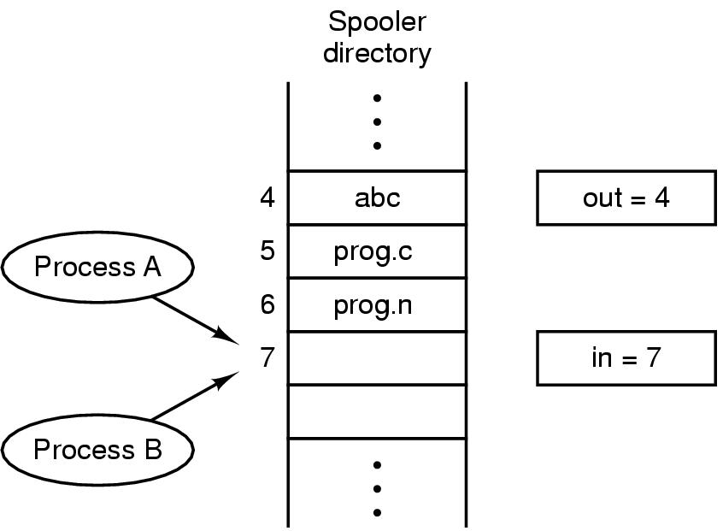
Race Condition
A race condition occurs when
Multiple processes or threads read and write data items
They do so in a way where the final result depends on the order of execution of the processes.
The output depends on who finishes the race last.

Slide 9
Properties of a good solution
Mutual exclusion
No assumptions about speeds or number of CPU’s
No process outside critical region can block other processes
No starvation-no process waits forever to enter critical region

Slide 10
Critical Section Problem
Consider system of n processes {p₀, p₁, … p_{n-1}}
Each process has critical section segment of code
Process may be changing common variables, updating table, writing file, etc
When one process in critical section, no other may be in its critical section
Critical section problem is to design protocol to solve this
Each process must ask permission to enter critical section in entry section, may follow critical section with exit section, then remainder section

Slide 11
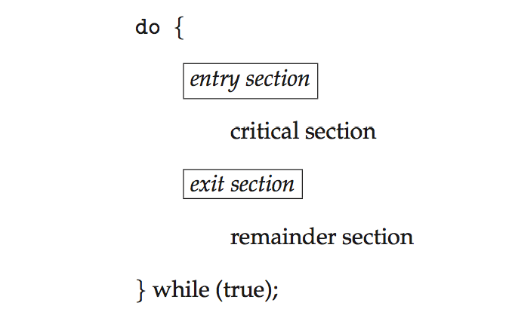
Critical Section
General structure of process P_{i}

Slide 12
First attempts
A laundry list of proposals to achieve mutual exclusion
Software Solutions
Lock variables
Strict alternation
Peterson's solution
Hardware Solutions
Disabling interrupts
TSL instruction

Slide 13
Algorithm1 for Process P_{i}
do {
while (flag == 1);
flag = 1;
critical section
flag = 0;
remainder section
} while (true);

Slide 14
Algorithm2 for Process P_{i}
do {
while (turn == j);
critical section
turn = j;
remainder section
} while (true);

Slide 15
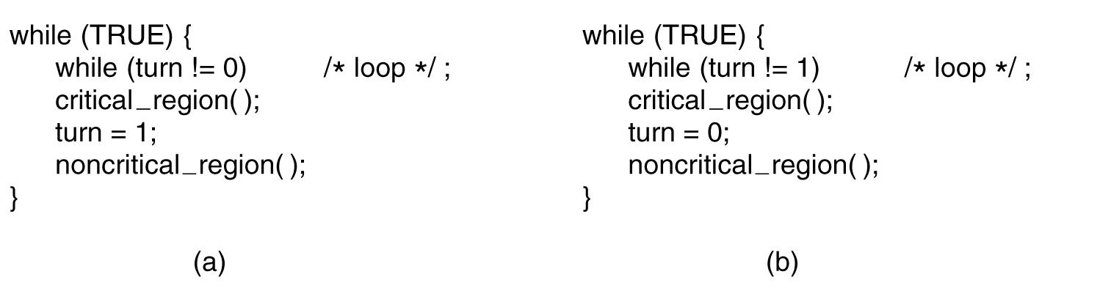
Strict alteration

Slide 16
Requirements for Mutual Exclusion
A process must not be delayed access to a critical section when there is no other process using it
No assumptions are made about relative process speeds or number of processes
A process remains inside its critical section for a finite time only
Only one process at a time is allowed in the critical section for a resource
A process that halts in its noncritical section must do so without interfering with other processes
No deadlock or starvation

Slide 17
Characteristics of solution to Critical-Section Problem
1. Mutual Exclusion - If process P_{i} is executing in its critical section, then no other processes can be executing in their critical sections
2. Progress - If no process is executing in its critical section and there exist some processes that wish to enter their critical section, then the selection of the processes that will enter the critical section next cannot be postponed indefinitely
3. Bounded Waiting - A bound must exist on the number of times that other processes are allowed to enter their critical sections after a process has made a request to enter its critical section and before that request is granted
Assume that each process executes at a nonzero speed
No assumption concerning relative speed of the n processes

Slide 18
Peterson’s Solution
Good algorithmic description of solving the problem
Two process solution
Assume that the load and store machine-language instructions are atomic; that is, cannot be interrupted
The two processes share two variables:
int turn;
Boolean flag[2]
The variable turn indicates whose turn it is to enter the critical section
The flag array is used to indicate if a process is ready to enter the critical section. flag[i] = true implies that process P_{i} is ready!

Slide 19

Algorithm for Process P_{i}
do {
flag[i] = true;
turn = j;
while (flag[j] && turn = = j);
critical section
flag[i] = false;
remainder section
} while (true);

Slide 20
Peterson’s Solution (Cont.)
Provable that the three CS requirement are met:
1. Mutual exclusion is preserved
P_{i} enters CS only if:
either flag[j] = false or turn = i
2. Progress requirement is satisfied
3. Bounded-waiting requirement is met

Slide 21
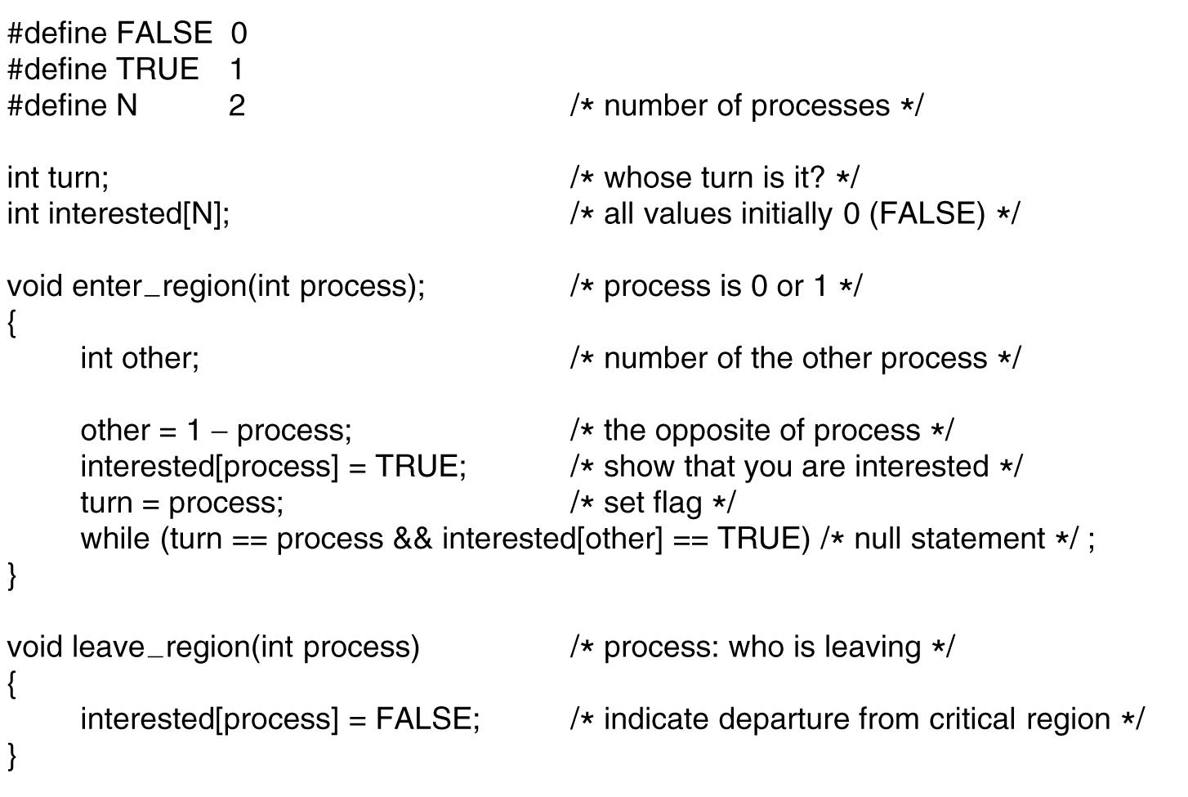
Peterson’s solution
What if there are 3 processes?

Slide 22
Disabling Interrupts
Uniprocessors only allow interleaving
Interrupt Disabling
A process runs until it invokes an operating system service or until it is interrupted
Disabling interrupts guarantees mutual exclusion
Will not work in multiprocessor architecture
Notes:
In a uniprocessor system, concurrent processes cannot have overlapped execution;
they can only be interleaved.
To guarantee mutual exclusion, it is sufficient to prevent a process from being interrupted.

Slide 23
Pseudo-Code
while (true) {
/* disable interrupts */;
/* critical section */;
/* enable interrupts */;
/* remainder */;
}
Notes:
Because the critical section cannot be interrupted, mutual exclusion is guaranteed.
The price of this approach, however, is high.
The efficiency of execution could be noticeably degraded because the processor is limited in its ability to interleave processes.

Slide 24
Synchronization Hardware
Many systems provide hardware support for implementing the critical section code.
All solutions below based on idea of locking
Protecting critical regions via locks
Uniprocessors – could disable interrupts
Currently running code would execute without preemption
Generally too inefficient on multiprocessor systems
Operating systems using this not broadly scalable
Modern machines provide special atomic hardware instructions
Atomic = non-interruptible
Either test memory word and set value
Or swap contents of two memory words

Slide 25
Solution to Critical-section Problem Using Locks
do {
acquire lock
critical section
release lock
remainder section
} while (TRUE);

Slide 26
test_and_set Instruction
Definition:
boolean test_and_set (boolean *target)
{
boolean rv = *target;
*target = TRUE;
return rv:
}
Executed atomically
Returns the original value of passed parameter
Set the new value of passed parameter to “TRUE”.

Slide 27
Solution using test_and_set()
Shared Boolean variable lock, initialized to FALSE
Solution:
do { while (test_and_set(&lock))
; /* do nothing */
/* critical section */
lock = false;
/* remainder section */
} while (true);

Slide 28
compare_and_swap Instruction
Definition:
int compare _and_swap(int *value, int expected, int new_value) {
int temp = *value;
if (*value == expected)
*value = new_value;
return temp;
}
Executed atomically
Returns the original value of passed parameter “value”
Set the variable “value” the value of the passed parameter “new_value” but only if “value” ==“expected”. That is, the swap takes place only under this condition.

Slide 29
Solution using compare_and_swap
Shared integer “lock” initialized to 0;
Solution:
do { while (compare_and_swap(&lock, 0, 1) != 0)
; /* do nothing */
/* critical section */
lock = 0;
/* remainder section */
} while (true);

Slide 30
Mutex Locks
Previous solutions are complicated and generally inaccessible to application programmers
OS designers build software tools to solve critical section problem
Simplest is mutex lock
Protect a critical section by first acquire() a lock then release() the lock
Boolean variable indicating if lock is available or not
Calls to acquire() and release() must be atomic
Usually implemented via hardware atomic instructions
But this solution requires busy waiting
This lock therefore called a spinlock

Slide 31
acquire() and release()
acquire() { while (!available)
; /* busy wait */
available = false;
}
release() {
available = true;
}
do {
acquire lock
critical section
release lock
remainder section
} while (true);

Slide 32
Semaphore
Synchronization tool that provides more sophisticated ways (than Mutex locks) for process to synchronize their activities.
Semaphore S – integer variable
Can only be accessed via two indivisible (atomic) operations
wait() and signal()
Originally called P() and V()

Slide 33
Semaphore
Definition of the wait() operation
wait(S) {
while (S <= 0)
; // busy wait
S--;
}
Definition of the signal() operation
signal(S) {
S++;
}

Slide 34
Semaphore Usage
Counting semaphore – integer value can range over an unrestricted domain
Binary semaphore – integer value can range only between 0 and 1
Same as a mutex lock
Can solve various synchronization problems

Slide 35
Semaphore Usage
Consider P₁ and P₂ that require S₁ to happen before S₂
Create a semaphore “synch” initialized to 0
P1:
S₁;
signal(synch);
P2:
wait(synch);
S₂;
Can implement a counting semaphore S as a binary semaphore

Slide 36
Semaphore Implementation
Must guarantee that no two processes can execute the wait() and signal() on the same semaphore at the same time
Thus, the implementation becomes the critical section problem where the wait and signal code are placed in the critical section
Could now have busy waiting in critical section implementation
But implementation code is short
Little busy waiting if critical section rarely occupied
Note that applications may spend lots of time in critical sections and therefore this is not a good solution

Slide 37
Semaphore Implementation with no Busy waiting
With each semaphore there is an associated waiting queue
Each entry in a waiting queue has two data items:
value (of type integer)
pointer to next record in the list
Two operations:
block – place the process invoking the operation on the appropriate waiting queue
wakeup – remove one of processes in the waiting queue and place it in the ready queue
typedef struct{
int value;
struct process *list;
} semaphore;

Slide 38
Implementation with no Busy waiting (Cont.)
wait(semaphore *S) {
S->value--;
if (S->value < 0) { add this process to S->list;
block();
}
}
signal(semaphore *S) {
S->value++;
if (S->value <= 0) { remove a process P from S->list;
wakeup(P);
}
}

Slide 39
Deadlock and Starvation
Deadlock – two or more processes are waiting indefinitely for an event that can be caused by only one of the waiting processes
Let S and Q be two semaphores initialized to 1
P₀ P₁
wait(S); wait(Q);
wait(Q); wait(S);
... ...
signal(S); signal(Q);
signal(Q); signal(S);
Starvation – indefinite blocking
A process may never be removed from the semaphore queue in which it is suspended
Priority Inversion – Scheduling problem when lower-priority process holds a lock needed by higher-priority process
Solved via priority-inheritance protocol

Slide 40
Classical Problems of Synchronization
Classical problems used to test newly-proposed synchronization schemes
Bounded-Buffer Problem
Readers and Writers Problem
Dining-Philosophers Problem

Slide 41
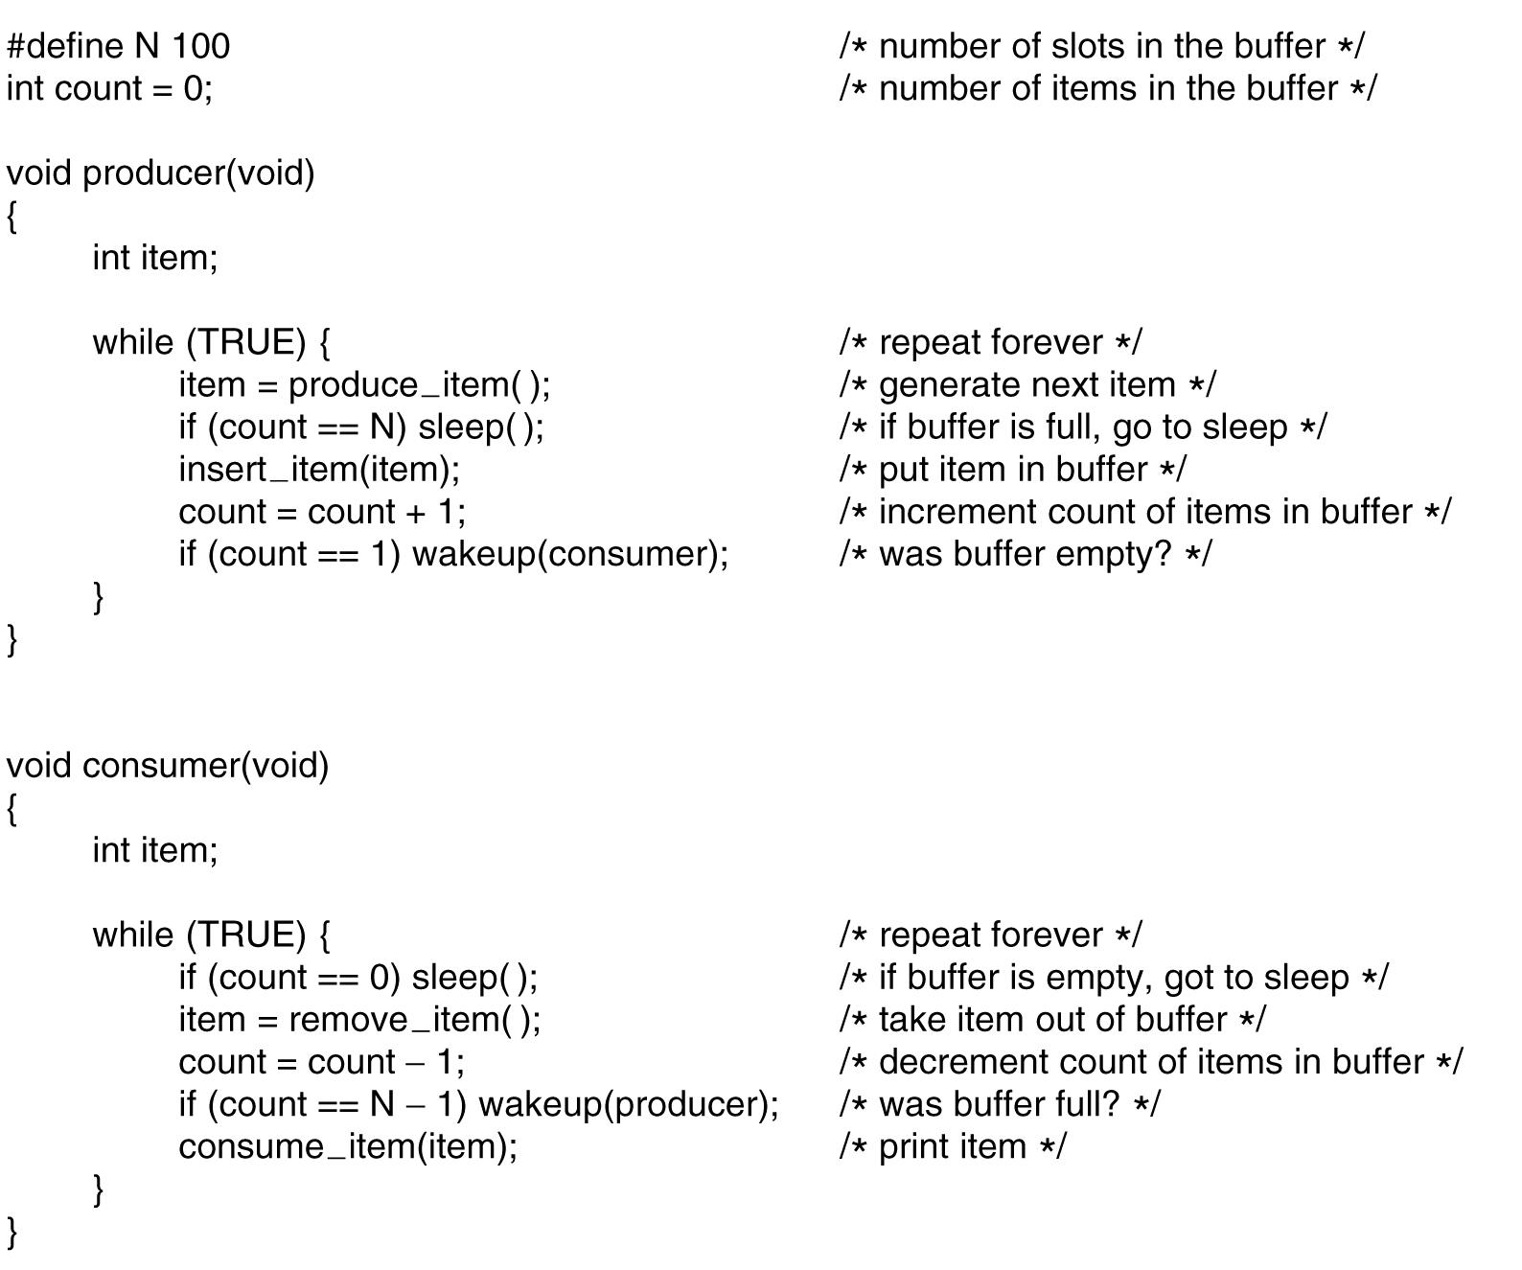
The Producer-Consumer Problem (aka Bounded Buffer Problem)
. . .
Tanenbaum, Modern Operating Systems 3 e, (c) 2008 Prentice-Hall, Inc. All rights reserved. 0-13-6006639

Slide 42
The problem with sleep and wake-up calls
Empty buffer,count==0
Consumer gets replaced by producer before it goes to sleep
Produces something, count++, sends wakeup to consumer
Consumer not asleep, ignores wakeup, thinks count= = 0, goes to sleep
Producer fills buffer, goes to sleep
P and C sleep forever
So the problem is lost wake-up calls
Tanenbaum, Modern Operating Systems 3 e, (c) 2008 Prentice-Hall, Inc. All rights reserved. 0-13-6006639

Slide 43
Solution of Bounded-Buffer Problem
n buffers, each can hold one item
Semaphore mutex initialized to the value 1
Semaphore full initialized to the value 0
Semaphore empty initialized to the value n

Slide 44
Solution of Bounded Buffer Problem (Cont.)
The structure of the producer process
do {
... /* produce an item in next_produced */
...
wait(empty);
wait(mutex);
... /* add next produced to the buffer */
...
signal(mutex);
signal(full);
} while (true);

Slide 45
Solution of Bounded Buffer Problem (Cont.)
The structure of the consumer process
Do {
wait(full);
wait(mutex);
... /* remove an item from buffer to next_consumed */
...
signal(mutex);
signal(empty);
... /* consume the item in next consumed */
... } while (true);

Slide 46
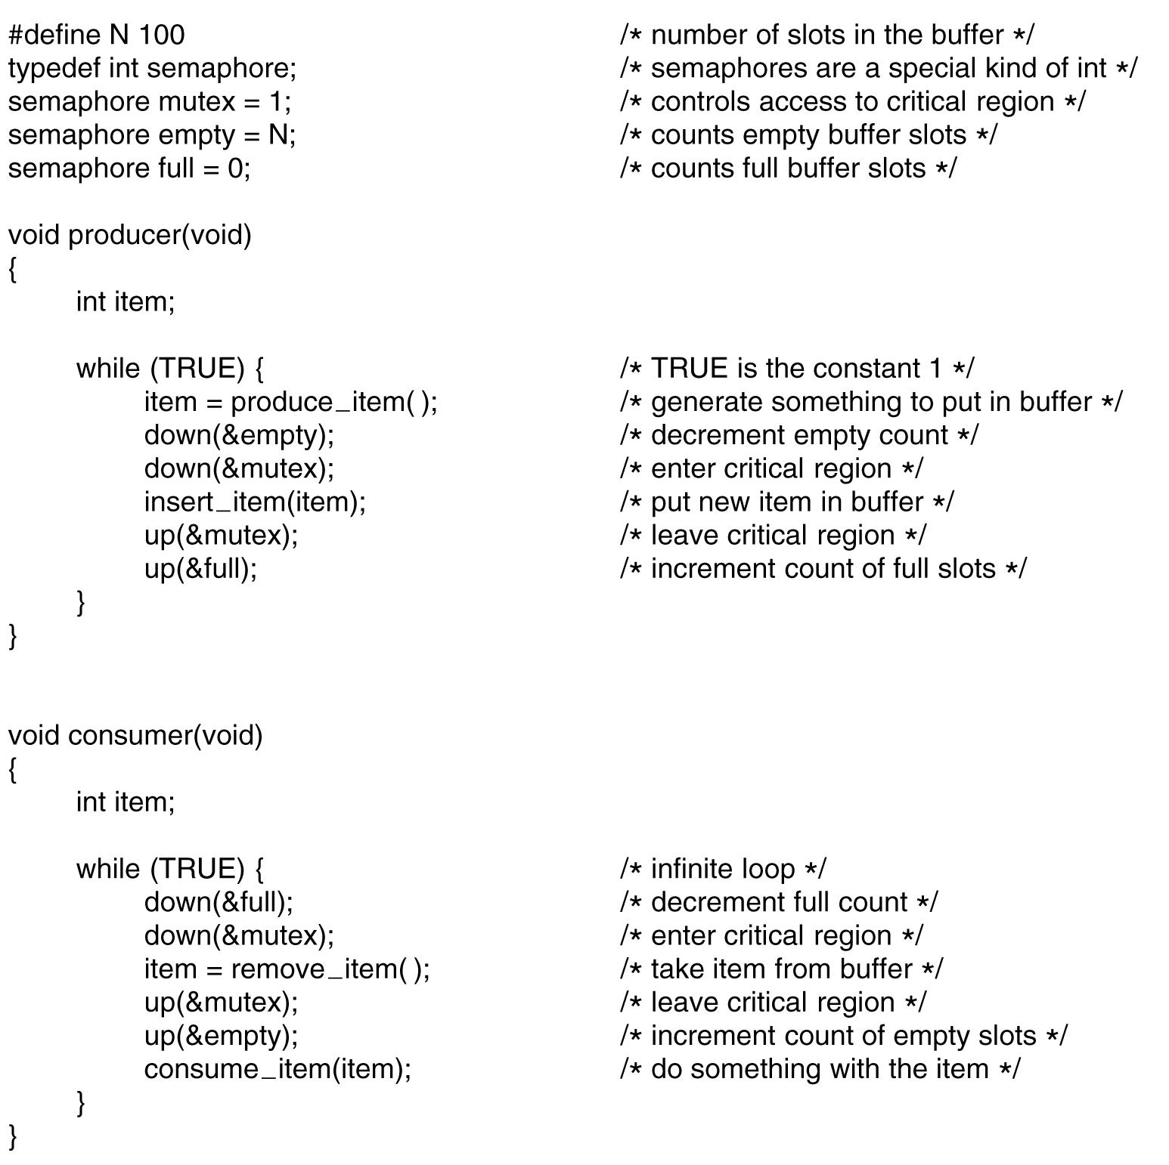
Producer Consumer with semaphores
. . .
Tanenbaum, Modern Operating Systems 3 e, (c) 2008 Prentice-Hall, Inc. All rights reserved. 0-13-6006639

Slide 47
Condition Variables
Allows a thread to block if a condition is not met, e.g. Producer-Consumer. Producer needs to block if the buffer is full.
Mutex make it possible to check if buffer is full
Condition variable makes it possible to put producer to sleep if buffer is full
Both are present in pthreads and are used together
Tanenbaum, Modern Operating Systems 3 e, (c) 2008 Prentice-Hall, Inc. All rights reserved. 0-13-6006639

Slide 48
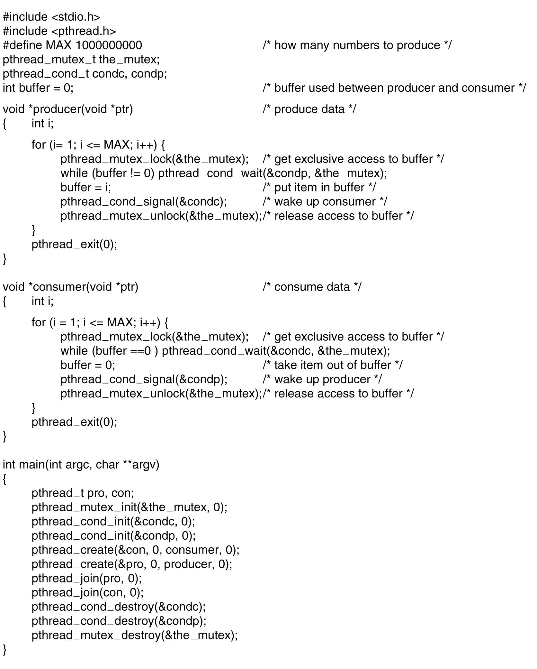
Producer Consumer with condition variables
. . .
.
Tanenbaum, Modern Operating Systems 3 e, (c) 2008 Prentice-Hall, Inc. All rights reserved. 0-13-6006639

Slide 49
Monitors
Easy to make a mess of things using mutexes and condition variables. Little errors cause disasters.
Producer consumer with semaphores- interchange two downs in producer code causes deadlock
Monitor is a language construct which enforces mutual exclusion and blocking mechanism
C does not have monitor
Tanenbaum, Modern Operating Systems 3 e, (c) 2008 Prentice-Hall, Inc. All rights reserved. 0-13-6006639

Slide 50
Monitors
Monitor consists of {procedures, data structures, and variables} grouped together in a “module”
A process can call procedures inside the monitor, but cannot directly access the stuff inside the monitor
C does not have monitors
Tanenbaum, Modern Operating Systems 3 e, (c) 2008 Prentice-Hall, Inc. All rights reserved. 0-13-6006639

Slide 51
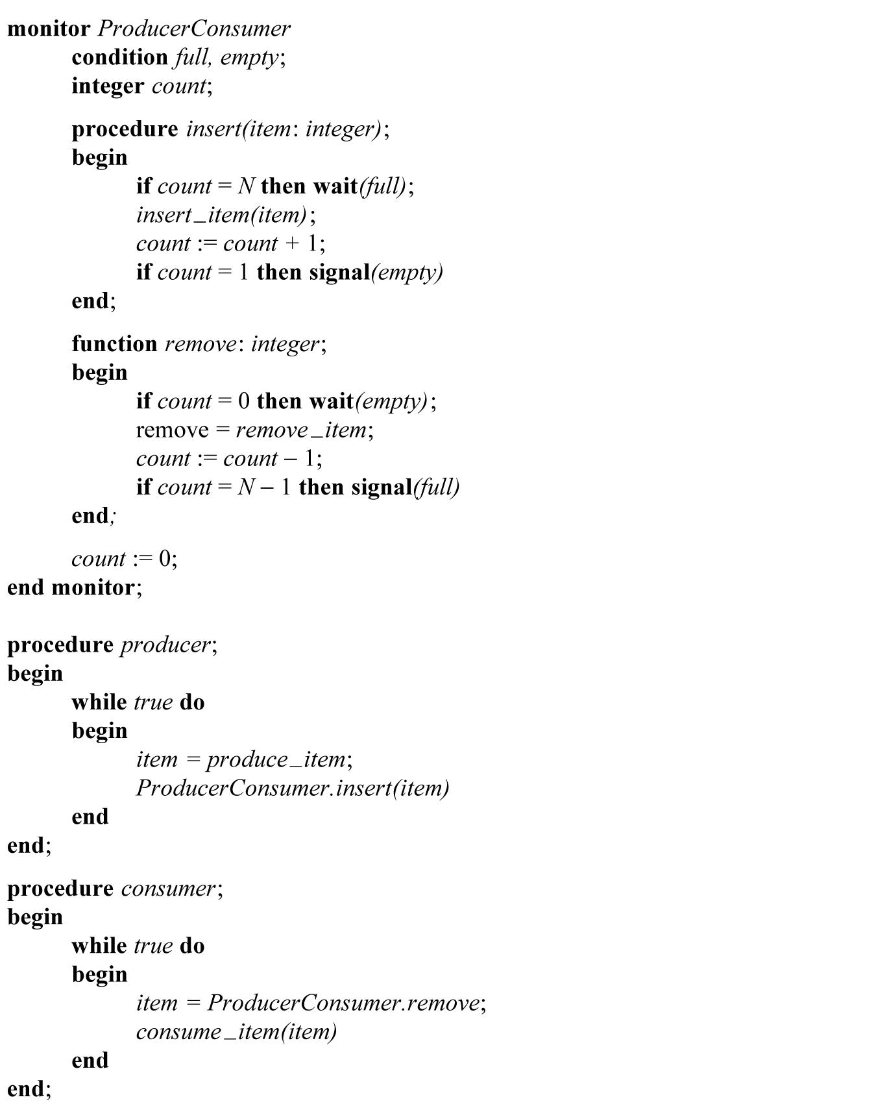
Producer Consumer Monitor
Tanenbaum, Modern Operating Systems 3 e, (c) 2008 Prentice-Hall, Inc. All rights reserved. 0-13-6006639

Slide 52
Monitors:Good vs Bad
The good-No messy direct programmer control of semaphores
The bad- You need a language which supports monitors (Java).
OS’s are written in C
Tanenbaum, Modern Operating Systems 3 e, (c) 2008 Prentice-Hall, Inc. All rights reserved. 0-13-6006639

Slide 53
Message Passing
Information exchange between machines
Two primitives
Send(destination, &message)
Receive(source,&message)
Lots of design issues
Message loss
acknowledgements, time outs deal with loss
Authentication-how does a process know the identity of the sender? For sure, that is
Tanenbaum, Modern Operating Systems 3 e, (c) 2008 Prentice-Hall, Inc. All rights reserved. 0-13-6006639

Slide 54
Producer Consumer Using Message Passing
Consumer sends N empty messages to producer
Producer fills message with data and sends to consumer
Tanenbaum, Modern Operating Systems 3 e, (c) 2008 Prentice-Hall, Inc. All rights reserved. 0-13-6006639

Slide 55
Producer-Consumer Problem with Message Passing (1)
. . .
.
Tanenbaum, Modern Operating Systems 3 e, (c) 2008 Prentice-Hall, Inc. All rights reserved. 0-13-6006639

Slide 56
Producer-Consumer Problem with Message Passing (2)
. . .
Tanenbaum, Modern Operating Systems 3 e, (c) 2008 Prentice-Hall, Inc. All rights reserved. 0-13-6006639

Slide 57
Section – 3: Principles of Deadlock
Conditions and Resource
Allocation Graphs
Deadlock Prevention
Deadlock Avoidance
Banker’s Algorithm
Deadlock Detection and Recovery
Dining Philosophers Problem

Slide 58
Deadlock
Permanent blocking of a set of processes that either compete for system resources or communicate with each other
No efficient solution
Involve conflicting needs for resources by two or more processes

Slide 59
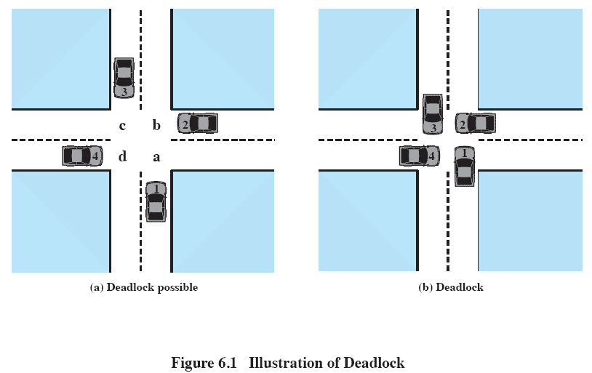
Deadlock

Slide 60
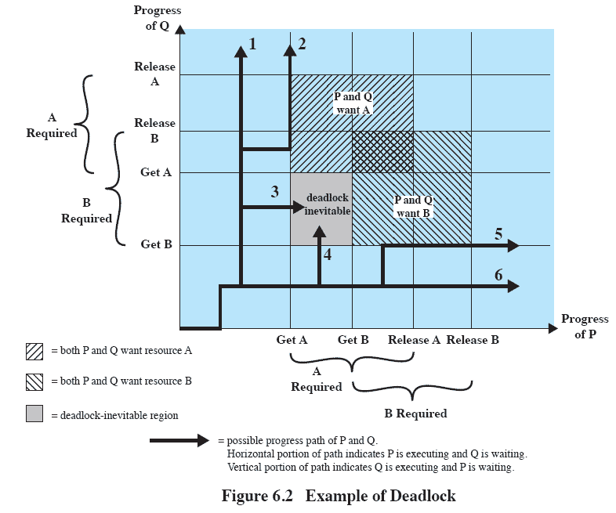
Deadlock

Slide 61
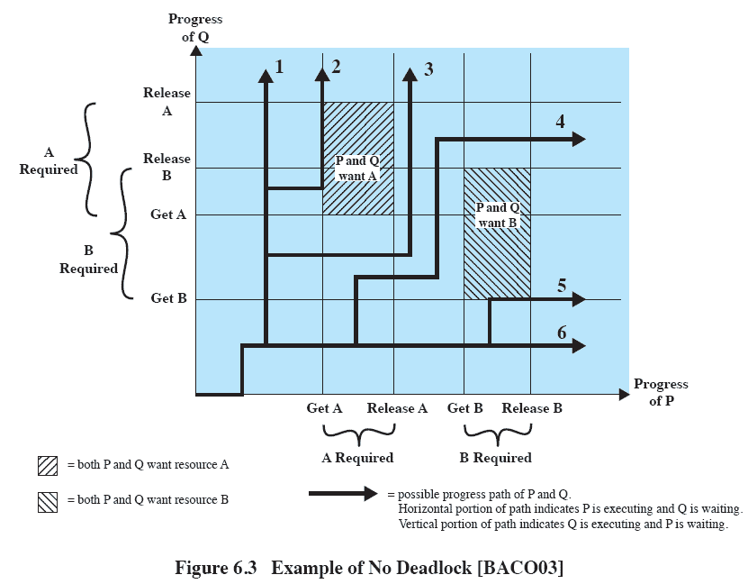
Deadlock

Slide 62
Possibility of Deadlock - Example
. . .
Tanenbaum, Modern Operating Systems 3 e, (c) 2008 Prentice-Hall, Inc. All rights reserved. 0-13-6006639

Slide 63
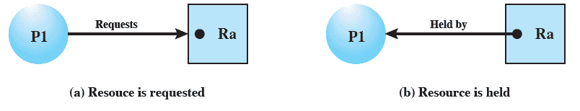
Resource Allocation Graphs
Directed graph that depicts a state of the system of resources and processes

Slide 64
Conditions for Deadlock
Mutual exclusion
Only one process may use a resource at a time
Hold-and-wait
A process may hold allocated resources while awaiting assignment of others

Slide 65
Conditions for Deadlock
No preemption
No resource can be forcibly removed form a process holding it
Circular wait
A closed chain of processes exists, such that each process holds at least one resource needed by the next process in the chain

Slide 66
Possibility of Deadlock
Mutual Exclusion
No preemption
Hold and wait

Slide 67
Existence of Deadlock
Mutual Exclusion
No preemption
Hold and wait
Circular wait

Slide 68
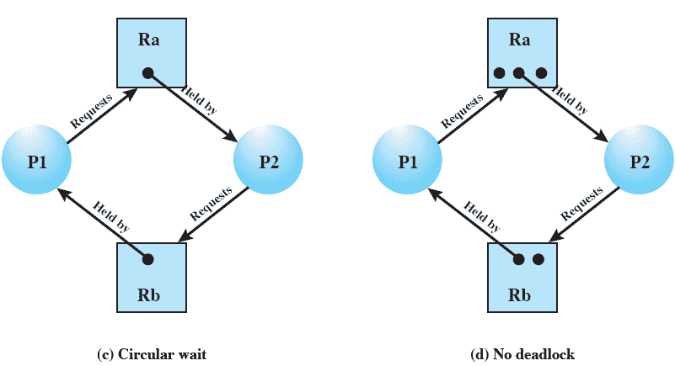
Resource Allocation Graphs

Slide 69
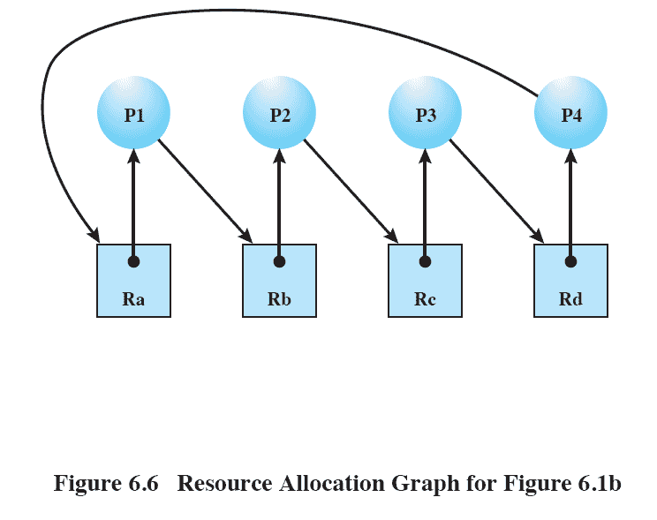
Resource Allocation Graphs

Slide 70
Resource-Allocation Graph
A set of vertices V and a set of edges E.
V is partitioned into two types:
P = {P₁, P₂, …, P_{n}}, the set consisting of all the processes in the system
R = {R₁, R₂, …, R_{m}}, the set consisting of all resource types in the system
request edge – directed edge P_{i} → R_{j}
assignment edge – directed edge R_{j} → P_{i}

Slide 71
Resource-Allocation Graph (Cont.)
Process
Resource Type with 4 instances
P_{i} requests instance of R_{j}
P_{i} is holding an instance of R_{j}
P_{i}
R_{j}
P_{i}
R_{j}

Slide 72
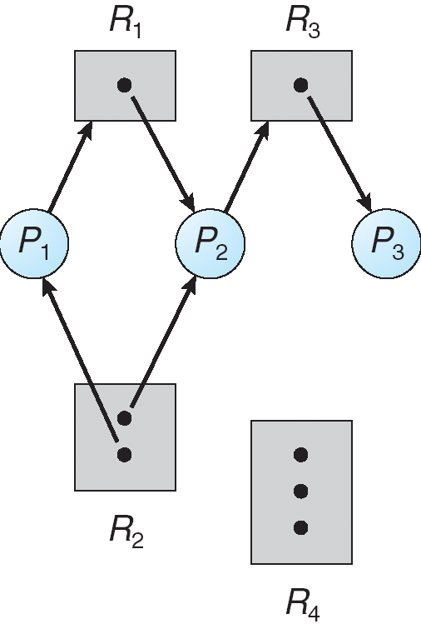
Example of a Resource Allocation Graph

Slide 73
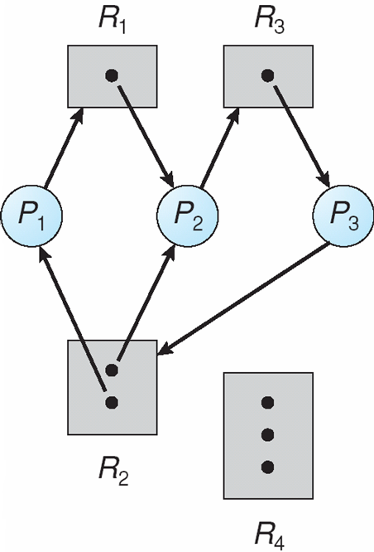
Resource Allocation Graph With A Deadlock

Slide 74
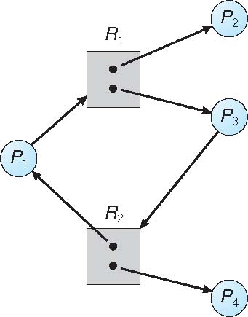
Graph With A Cycle But No Deadlock

Slide 75
Basic Facts
If graph contains no cycles ⇒ no deadlock
If graph contains a cycle ⇒
if only one instance per resource type, then deadlock
if several instances per resource type, possibility of deadlock

Slide 76
Methods for Handling Deadlocks
Ensure that the system will never enter a deadlock state:
Deadlock prevention
Deadlock avoidence
Allow the system to enter a deadlock state and then recover
Ignore the problem and pretend that deadlocks never occur in the system; used by most operating systems, including UNIX

Slide 77
Deadlock Prevention
Restrain the ways request can be made
Mutual Exclusion – not required for sharable resources (e.g., read-only files); must hold for non-sharable resources
Hold and Wait – must guarantee that whenever a process requests a resource, it does not hold any other resources
Require process to request and be allocated all its resources before it begins execution, or allow process to request resources only when the process has none allocated to it.
Low resource utilization; starvation possible

Slide 78
Deadlock Prevention (Cont.)
No Preemption –
If a process that is holding some resources requests another resource that cannot be immediately allocated to it, then all resources currently being held are released
Preempted resources are added to the list of resources for which the process is waiting
Process will be restarted only when it can regain its old resources, as well as the new ones that it is requesting
Circular Wait – impose a total ordering of all resource types, and require that each process requests resources in an increasing order of enumeration

Slide 79
Deadlock Example
/* thread one runs in this function */
void *do_work_one(void *param) {
pthread_mutex_lock(&first_mutex);
pthread_mutex_lock(&second_mutex);
/** * Do some work */ pthread_mutex_unlock(&second_mutex);
pthread_mutex_unlock(&first_mutex);
pthread_exit(0);
}
/* thread two runs in this function */
void *do_work_two(void *param) {
pthread_mutex_lock(&second_mutex);
pthread_mutex_lock(&first_mutex);
/** * Do some work */ pthread_mutex_unlock(&first_mutex);
pthread_mutex_unlock(&second_mutex);
pthread_exit(0);
}

Slide 80
Deadlock Example with Lock Ordering
void transaction(Account from, Account to, double amount)
{
mutex lock1, lock2;
lock1 = get_lock(from);
lock2 = get_lock(to);
acquire(lock1);
acquire(lock2);
withdraw(from, amount);
deposit(to, amount);
release(lock2);
release(lock1);
}
Transactions 1 and 2 execute concurrently. Transaction 1 transfers $25 from account A to account B, and Transaction 2 transfers $50 from account B to account A

Slide 81
Deadlock Avoidance
Requires that the system has some additional a priori information available
Simplest and most useful model requires that each process declare the maximum number of resources of each type that it may need
The deadlock-avoidance algorithm dynamically examines the resource-allocation state to ensure that there can never be a circular-wait condition
Resource-allocation state is defined by the number of available and allocated resources, and the maximum demands of the processes

Slide 82
Safe State
When a process requests an available resource, system must decide if immediate allocation leaves the system in a safe state
System is in safe state if there exists a sequence <P₁, P₂, …, P_{n}> of ALL the processes in the systems such that for each P_{i}, the resources that P_{i} can still request can be satisfied by currently available resources + resources held by all the P_{j}, with j < I
That is:
If P_{i} resource needs are not immediately available, then P_{i} can wait until all P_{j} have finished
When P_{j} is finished, P_{i} can obtain needed resources, execute, return allocated resources, and terminate
When P_{i} terminates, P_{i +1} can obtain its needed resources, and so on

Slide 83
Basic Facts
If a system is in safe state ⇒ no deadlocks
If a system is in unsafe state ⇒ possibility of deadlock
Avoidance ⇒ ensure that a system will never enter an unsafe state.

Slide 84
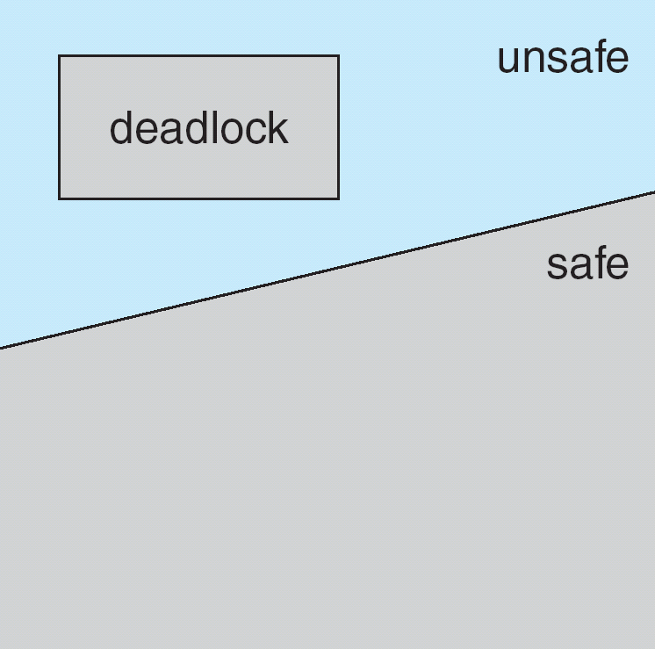
Safe, Unsafe, Deadlock State

Slide 85
Avoidance Algorithms
Single instance of a resource type
Use a resource-allocation graph
Multiple instances of a resource type
Use the banker’s algorithm

Slide 86
Resource-Allocation Graph Scheme
Claim edge P_{i} → R_{j} indicated that process P_{j} may request resource R_{j}; represented by a dashed line
Claim edge converts to request edge when a process requests a resource
Request edge converted to an assignment edge when the resource is allocated to the process
When a resource is released by a process, assignment edge reconverts to a claim edge
Resources must be claimed a priori in the system

Slide 87
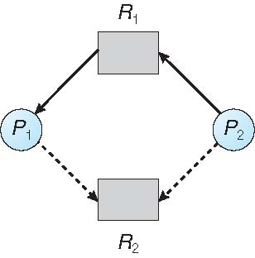
Resource-Allocation Graph

Slide 88
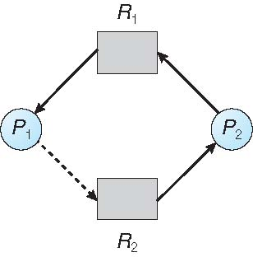
Unsafe State In Resource-Allocation Graph

Slide 89
Resource-Allocation Graph Algorithm
Suppose that process P_{i} requests a resource R_{j}
The request can be granted only if converting the request edge to an assignment edge does not result in the formation of a cycle in the resource allocation graph

Slide 90
Banker’s Algorithm
Multiple instances
Each process must a priori claim maximum use
When a process requests a resource it may have to wait
When a process gets all its resources it must return them in a finite amount of time

Slide 91
Data Structures for the Banker’s Algorithm
Let n = number of processes, and m = number of resources types.
Available: Vector of length m. If available [j] = k, there are k instances of resource type R_{j} available
Max: n x m matrix. If Max [i,j] = k, then process P_{i} may request at most k instances of resource type R_{j}
Allocation: n x m matrix. If Allocation[i,j] = k then P_{i} is currently allocated k instances of R_{j}
Need: n x m matrix. If Need[i,j] = k, then P_{i} may need k more instances of R_{j} to complete its task
Need [i,j] = Max[i,j] – Allocation [i,j]

Slide 92
Safety Algorithm
1. Let Work and Finish be vectors of length m and n, respectively. Initialize:
Work = Available
Finish [i] = false for i = 0, 1, …, n- 1
2. Find an i such that both:
(a) Finish [i] = false
(b) Need_{i} ≤ Work
If no such i exists, go to step 4
3. Work = Work + Allocation_{i} Finish[i] = true go to step 2
4. If Finish [i] == true for all i, then the system is in a safe state

Slide 93
Resource-Request Algorithm for Process P_{i}
Request_{i} = request vector for process P_{i}. If Request_{i} [j] = k then process P_{i} wants k instances of resource type R_{j}
1. If Request_{i} ≤ Need_{i} go to step 2. Otherwise, raise error condition, since process has exceeded its maximum claim
2. If Request_{i} ≤ Available, go to step 3. Otherwise P_{i} must wait, since resources are not available
3. Pretend to allocate requested resources to P_{i} by modifying the state as follows:
Available = Available – Request_{i};
Allocation_{i} = Allocation_{i} + Request_{i};
Need_{i} = Need_{i} – Request_{i};
If safe ⇒ the resources are allocated to P_{i}
If unsafe ⇒ P_{i} must wait, and the old resource-allocation state is restored

Slide 94
Example of Banker’s Algorithm
5 processes P₀ through P₄;
3 resource types:
A (10 instances), B (5instances), and C (7 instances)
Snapshot at time T₀:
Allocation Max Available
A B C A B C A B C
P₀ 0 1 0 7 5 3 3 3 2
P₁ 2 0 0 3 2 2
P₂ 3 0 2 9 0 2
P₃ 2 1 1 2 2 2
P₄ 0 0 2 4 3 3

Slide 95
Example (Cont.)
The content of the matrix Need is defined to be Max – Allocation
Need
A B C
P₀ 7 4 3
P₁ 1 2 2
P₂ 6 0 0
P₃ 0 1 1
P₄ 4 3 1
The system is in a safe state since the sequence < P₁, P₃, P₄, P₂, P₀> satisfies safety criteria

Slide 96
Example: P₁ Request (1,0,2)
Check that Request ≤ Available (that is, (1,0,2) ≤ (3,3,2) ⇒ true
Allocation Need Available
A B C A B C A B C
P₀ 0 1 0 7 4 3 2 3 0
P₁ 3 0 2 0 2 0
P₂ 3 0 2 6 0 0
P₃ 2 1 1 0 1 1
P₄ 0 0 2 4 3 1
Executing safety algorithm shows that sequence < P₁, P₃, P₄, P₀, P₂> satisfies safety requirement
Can request for (3,3,0) by P₄ be granted?
Can request for (0,2,0) by P₀ be granted?

Slide 97
Deadlock Detection
Allow system to enter deadlock state
Detection algorithm
Recovery scheme

Slide 98
Single Instance of Each Resource Type
Maintain wait-for graph
Nodes are processes
P_{i} → P_{j} if P_{i} is waiting for P_{j}
Periodically invoke an algorithm that searches for a cycle in the graph. If there is a cycle, there exists a deadlock
An algorithm to detect a cycle in a graph requires an order of n² operations, where n is the number of vertices in the graph

Slide 99
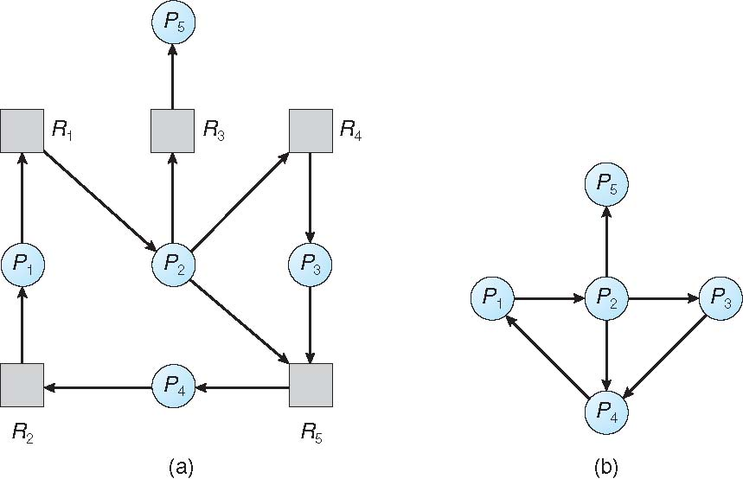
Resource-Allocation Graph and Wait-for Graph
Resource-Allocation Graph
Corresponding wait-for graph

Slide 100
Several Instances of a Resource Type
Available: A vector of length m indicates the number of available resources of each type
Allocation: An n x m matrix defines the number of resources of each type currently allocated to each process
Request: An n x m matrix indicates the current request of each process. If Request [i][j] = k, then process P_{i} is requesting k more instances of resource type R_{j}.

Slide 101
Detection Algorithm
1. Let Work and Finish be vectors of length m and n, respectively Initialize:
(a) Work = Available
(b) For i = 1,2, …, n, if Allocation_{i} ≠ 0, then Finish[i] = false; otherwise, Finish[i] = true
2. Find an index i such that both:
(a) Finish[i] == false
(b) Request_{i} ≤ Work
If no such i exists, go to step 4

Slide 102
Detection Algorithm (Cont.)
3. Work = Work + Allocation_{i} Finish[i] = true go to step 2
4. If Finish[i] == false, for some i, 1 ≤ i ≤ n, then the system is in deadlock state. Moreover, if Finish[i] == false, then P_{i} is deadlocked
Algorithm requires an order of O(m x n²) operations to detect whether the system is in deadlocked state

Slide 103
Example of Detection Algorithm
Five processes P₀ through P₄; three resource types A (7 instances), B (2 instances), and C (6 instances)
Snapshot at time T₀:
Allocation Request Available
A B C A B C A B C
P₀ 0 1 0 0 0 0 0 0 0
P₁ 2 0 0 2 0 2
P₂ 3 0 3 0 0 0
P₃ 2 1 1 1 0 0
P₄ 0 0 2 0 0 2
Sequence <P₀, P₂, P₃, P₁, P₄> will result in Finish[i] = true for all i

Slide 104
Example (Cont.)
P₂ requests an additional instance of type C
Request
A B C
P₀ 0 0 0
P₁ 2 0 2
P₂ 0 0 1
P₃ 1 0 0
P₄ 0 0 2
State of system?
Can reclaim resources held by process P₀, but insufficient resources to fulfill other processes; requests
Deadlock exists, consisting of processes P₁, P₂, P₃, and P₄

Slide 105
Detection-Algorithm Usage
When, and how often, to invoke depends on:
How often a deadlock is likely to occur?
How many processes will need to be rolled back?
one for each disjoint cycle
If detection algorithm is invoked arbitrarily, there may be many cycles in the resource graph and so we would not be able to tell which of the many deadlocked processes “caused” the deadlock.

Slide 106
Recovery from Deadlock: Process Termination
Abort all deadlocked processes
Abort one process at a time until the deadlock cycle is eliminated
In which order should we choose to abort?
Priority of the process
How long process has computed, and how much longer to completion
Resources the process has used
Resources process needs to complete
How many processes will need to be terminated
Is process interactive or batch?

Slide 107
Recovery from Deadlock: Resource Preemption
Selecting a victim – minimize cost
Rollback – return to some safe state, restart process for that state
Starvation – same process may always be picked as victim, include number of rollback in cost factor

Slide 108
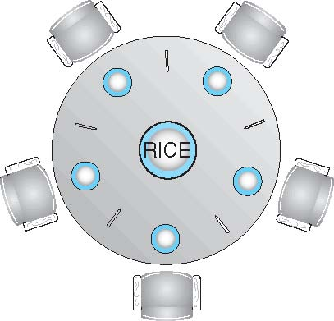
Dining-Philosophers Problem
Philosophers spend their lives alternating thinking and eating
Don’t interact with their neighbors, occasionally try to pick up 2 chopsticks (one at a time) to eat from bowl
Need both to eat, then release both when done
In the case of 5 philosophers
Shared data
Bowl of rice (data set)
Semaphore chopstick [5] initialized to 1

Slide 109
Dining-Philosophers Problem Algorithm
The structure of Philosopher i:
do {
wait (chopstick[i] );
wait (chopStick[ (i + 1) % 5] );
// eat
signal (chopstick[i] );
signal (chopstick[ (i + 1) % 5] );
// think
} while (TRUE);
What is the problem with this algorithm?

Slide 110
Dining-Philosophers Problem Algorithm (Cont.)
Deadlock handling
Allow at most 4 philosophers to be sitting simultaneously at the table.
Allow a philosopher to pick up the forks only if both are available (picking must be done in a critical section.
Use an asymmetric solution -- an odd-numbered philosopher picks up first the left chopstick and then the right chopstick. Even-numbered philosopher picks up first the right chopstick and then the left chopstick.

Slide 111
Problems with Semaphores
Incorrect use of semaphore operations:
signal (mutex) …. wait (mutex)
wait (mutex) … wait (mutex)
Omitting of wait (mutex) or signal (mutex) (or both)
Deadlock and starvation are possible.

Slide 112
Monitors
A high-level abstraction that provides a convenient and effective mechanism for process synchronization
Abstract data type, internal variables only accessible by code within the procedure
Only one process may be active within the monitor at a time
But not powerful enough to model some synchronization schemes
monitor monitor-name
{
// shared variable declarations
procedure P1 (…) { …. }
procedure Pn (…) {……}
Initialization code (…) { … }
}
}

Slide 113
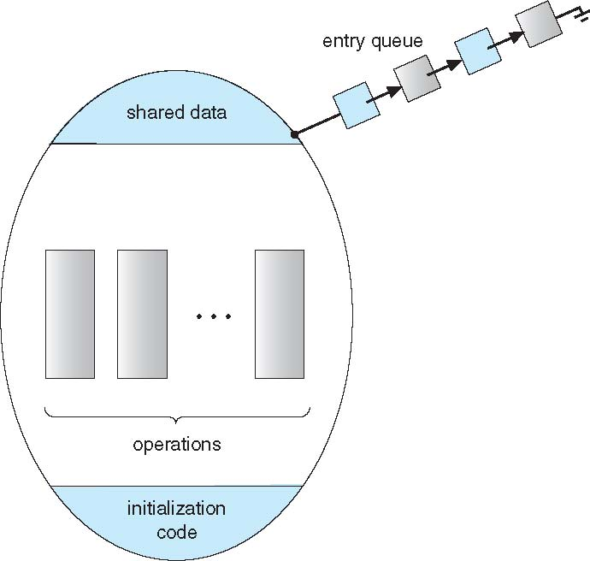
Schematic view of a Monitor

Slide 114
Condition Variables
condition x, y;
Two operations are allowed on a condition variable:
x.wait() – a process that invokes the operation is suspended until x.signal()
x.signal() – resumes one of processes (if any) that invoked x.wait()
If no x.wait() on the variable, then it has no effect on the variable

Slide 115
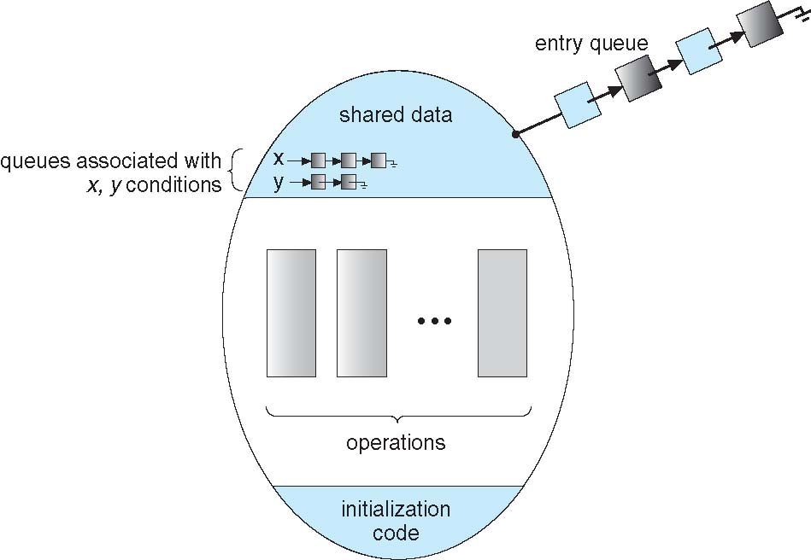
Monitor with Condition Variables

Slide 116
Condition Variables Choices
If process P invokes x.signal(), and process Q is suspended in x.wait(), what should happen next?
Both Q and P cannot execute in paralel. If Q is resumed, then P must wait
Options include
Signal and wait – P waits until Q either leaves the monitor or it waits for another condition
Signal and continue – Q waits until P either leaves the monitor or it waits for another condition
Both have pros and cons – language implementer can decide
Monitors implemented in Concurrent Pascal compromise
P executing signal immediately leaves the monitor, Q is resumed
Implemented in other languages including Mesa, C#, Java

Slide 117
Monitor Solution to Dining Philosophers
monitor DiningPhilosophers
{
enum { THINKING; HUNGRY, EATING) state [5] ;
condition self [5];
void pickup (int i) {
state[i] = HUNGRY;
test(i);
if (state[i] != EATING) self[i].wait;
}
void putdown (int i) {
state[i] = THINKING;
// test left and right neighbors
test((i + 4) % 5);
test((i + 1) % 5);
}

Slide 118
Solution to Dining Philosophers (Cont.)
void test (int i) {
if ((state[(i + 4) % 5] != EATING) &&
(state[i] == HUNGRY) &&
(state[(i + 1) % 5] != EATING) ) {
state[i] = EATING ;
self[i].signal () ;
}
}
initialization_code() {
for (int i = 0; i < 5; i++)
state[i] = THINKING;
}
}

Slide 119
Solution to Dining Philosophers (Cont.)
Each philosopher i invokes the operations pickup() and putdown() in the following sequence:
DiningPhilosophers.pickup(i);
EAT
DiningPhilosophers.putdown(i);
No deadlock, but starvation is possible

Slide 120
Monitor Implementation Using Semaphores
Variables
semaphore mutex; // (initially = 1)
semaphore next; // (initially = 0)
int next_count = 0;
Each procedure F will be replaced by
wait(mutex);
…
body of F;
…
if (next_count > 0)
signal(next)
else
signal(mutex);
Mutual exclusion within a monitor is ensured

Slide 121
Monitor Implementation – Condition Variables
For each condition variable x, we have:
semaphore x_sem; // (initially = 0)
int x_count = 0;
The operation x.wait can be implemented as:
x_count++;
if (next_count > 0)
signal(next);
else
signal(mutex);
wait(x_sem);
x_count--;

Slide 122
Monitor Implementation (Cont.)
The operation x.signal can be implemented as:
if (x_count > 0) {
next_count++;
signal(x_sem);
wait(next);
next_count--;
}

Slide 123
Resuming Processes within a Monitor
If several processes queued on condition x, and x.signal() executed, which should be resumed?
FCFS frequently not adequate
conditional-wait construct of the form x.wait(c)
Where c is priority number
Process with lowest number (highest priority) is scheduled next

Slide 124
THANK YOU!!

